Slide 1

Everything a Startup Needs to Know About IP
January 23, 2024

Slide 2
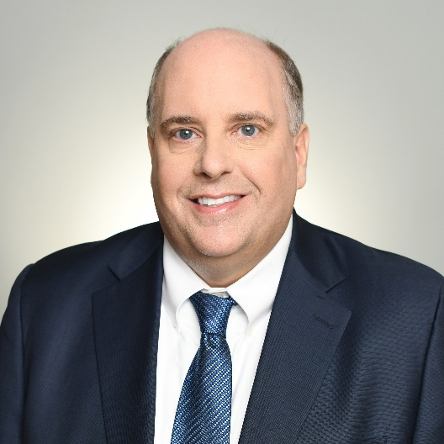

Meet the Speakers
Jeff Barclay
Principal
Peter Fasse
Principal
Barclay@fr.com
peter.fasse@fr.com

Slide 3
IP Fundamentals Importance of a Strong IP Portfolio Types of Patent Applications Patent Application Examination IP Do’s and Don’ts for Startups Memorialize Work
Agenda

Slide 4
IP Fundamentals

Slide 5
IP Fundamentals
Roadmap
Intellectual Property Overview
Patents
Trademarks
Trade Secrets
Copyrights
The Importance of IP to Early-Stage Projects
Building an IP Portfolio
Strategy
Public disclosure and grace period
Best Practices

Slide 6
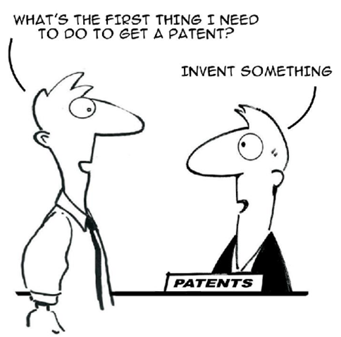
IP Fundamentals
What is Intellectual Property?
Ideas – your intangible scientific and business assets
Can be protected in the form of:
Patents
Trademarks
Copyrights
Trade secrets

Slide 7
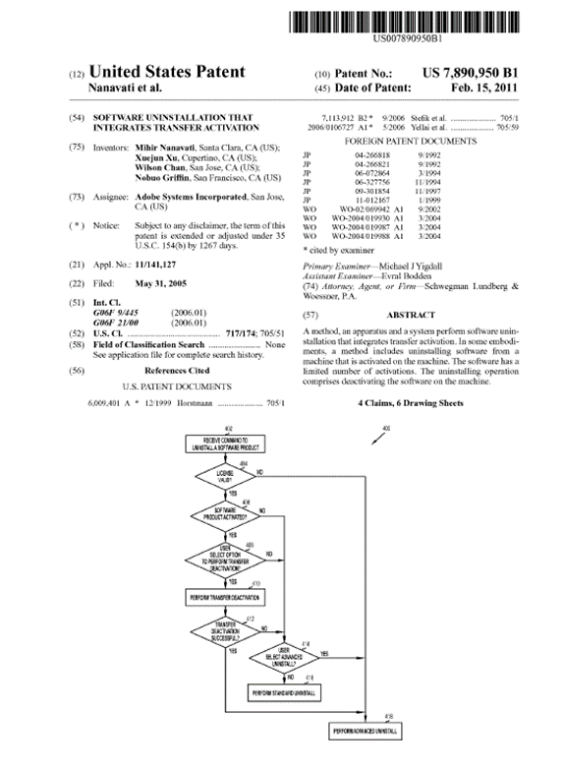
IP Fundamentals
What is a Patent?
A document that provides to the patent owner the right to prevent others from making, using, offering sell, selling or importing the invention(s) claimed in the patent.
Protection lasts approximately 20 year from filing.

Slide 8
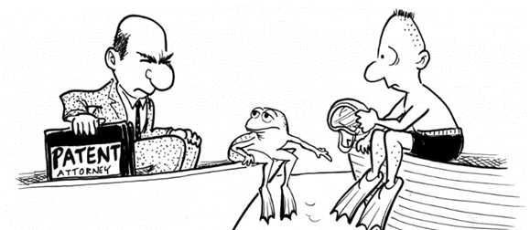
IP Fundamentals
What is a Patent?
A “ticket to court”
Gives the patent owner a negative right – BUT it does not give its owner the affirmative right to make, use, sell, or offer to sell his invention.
Can be bought, sold, licensed, bequeathed, etc.

Slide 9
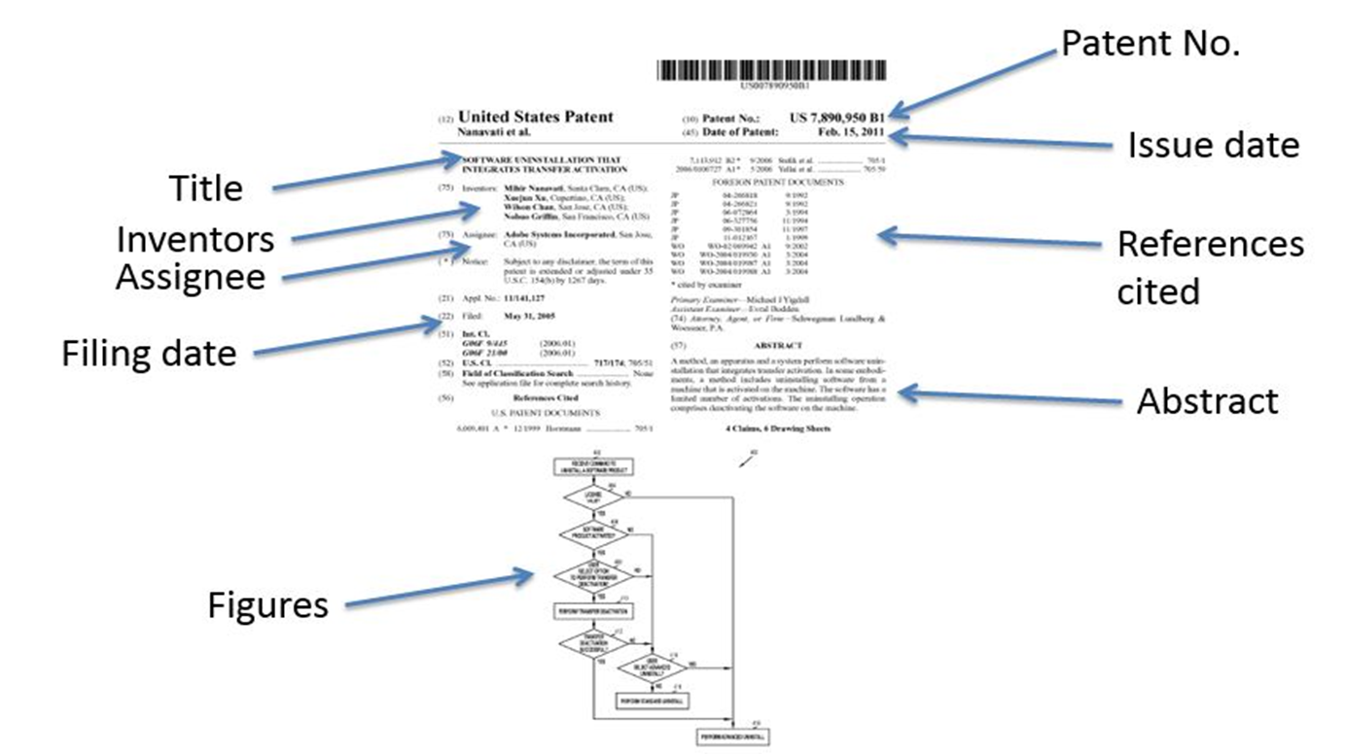
IP Fundamentals
Anatomy of a Patent

Slide 10
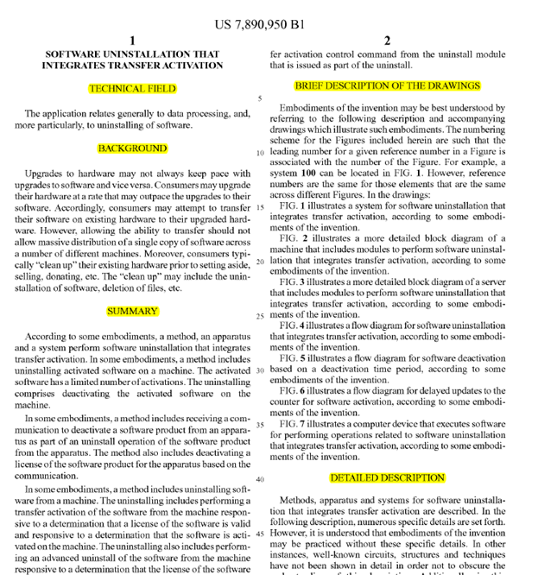
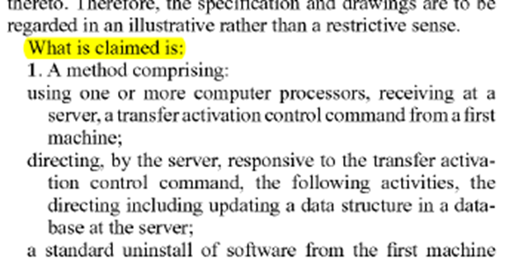
IP Fundamentals
Anatomy of a Patent
Claims

Slide 11
IP Fundamentals
What is a Trademark?
A registration with a governmental entity (federal or state) that provides the registration owner a right to prevent others from using the registered mark.
Protects words, phrases, logos, product configurations, packaging, sounds, smells, etc. – essentially anything that identifies a source of origin
Theoretically can last forever (subject to renewal and continuous use)

Slide 12
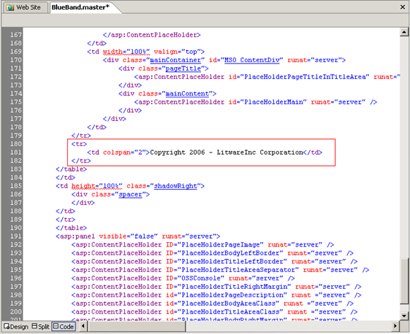
IP Fundamentals
What is a Copyright?
The right to copy, distribute perform
Original expression
Often used to protect software codes
Generally owned by the author
Protection lasts for the lifetime of the author + 70 years

Slide 13
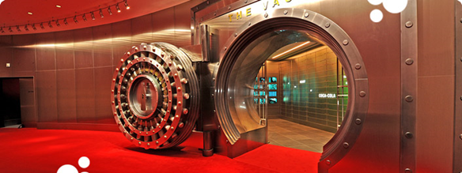
IP Fundamentals
What is a Trade Secret
Protecting your idea by keeping it secret
Types of ideas that can be trade secrets:
Formulae
Data compilations
Programs
Processes
Devices
Key consideration: Does it have independent economic value from not being known to others?
No filing requirements
Protection lasts as long as it’s secret.
Challenging for software, particularly open source

Slide 14
IP Fundamentals -
The Importance of IP to Early-Stage Projects
Generation of revenue by way of royalty payments
Support a proprietary device, compound, process or method
Support a licensing model
Exclude competitors from best products or most efficient processes
Capture competitive advantage
Discourage knock-offs and counterfeits
Bargaining chips to exchange with other companies for use of their intellectual property
Gain defensive counterattacks
Increase competitors’ risk and levels of uncertainty
Offensive licensing/litigation assertion, as consistent with business objectives

Slide 15
IP Fundamentals
Building an IP Portfolio
Develop an IP strategy early and review it regularly
Be aware of what you tell others
Establish proof of invention/ownership
Consider acquisition strategies for jumpstarting portfolios
Decide on timing of filing applications

Slide 16
IP Fundamentals
Building an IP Portfolio
Identifying Potentially Patentable Inventions
In general, any innovation or development that solves a problem or provides an advantage (enhanced functionality, better, cheaper, faster, easier to use, increased efficiency, less memory, fewer components, etc.) is potentially patentable
New products or services
Delta between successive versions
Potentially valuable to pursue patent protection on ideas not to be commercialized or otherwise pursued
Goal is to prevent your competitors from being able to use them as alternatives to your patented technology

Slide 17
IP Fundamentals
Public Disclosure and Grace Period
An inventor’s public disclosures will not preclude a patent (in the United States), if the patent application is filed within one year of the disclosure
AKA the “grace period”
An inventor’s public article and speeches are not prior art if made within one year of patent application
Unclear whether the grace period applies to public uses or sales
But rights may be lost in other jurisdictions (e.g., United Kingdom)
Safest approach is to get an application on file before any public disclosure

Slide 18
IP Fundamentals
Best Practices
Maintain retraceable trail of your research
Dated versions of codes, documents etc. (lab notebooks…anyone?!)
Capture notes from brainstorming meets
Be careful about what you put in emails (and voicemails)
Particularly when discussing “prior art”, or competitors’ products etc.
Use face-to-face meetings or phone calls for potentially sensitive topics
Avoid commenting on related patents/products on social networks etc. as much as possible
Submit your ideas as soon as possible (but with sufficient details)
Disclose known prior art
Be aware of what you tell others

Slide 19
IP Fundamentals
Filing Patent Applications
Option 1: Start with a full U.S. utility application and eventually file in other countries (European countries) via the patent cooperation treaty (PCT) route
Option 2: Start with a provisional U.S. application and eventually file in other countries via the patent cooperation treaty (PCT) route
Option 3: Start with a full U.S. utility application and go through expedited prosecution and eventually file in outer countries via the patent cooperation treaty (PCT) route
Important: Choose the “other countries” carefully

Slide 20
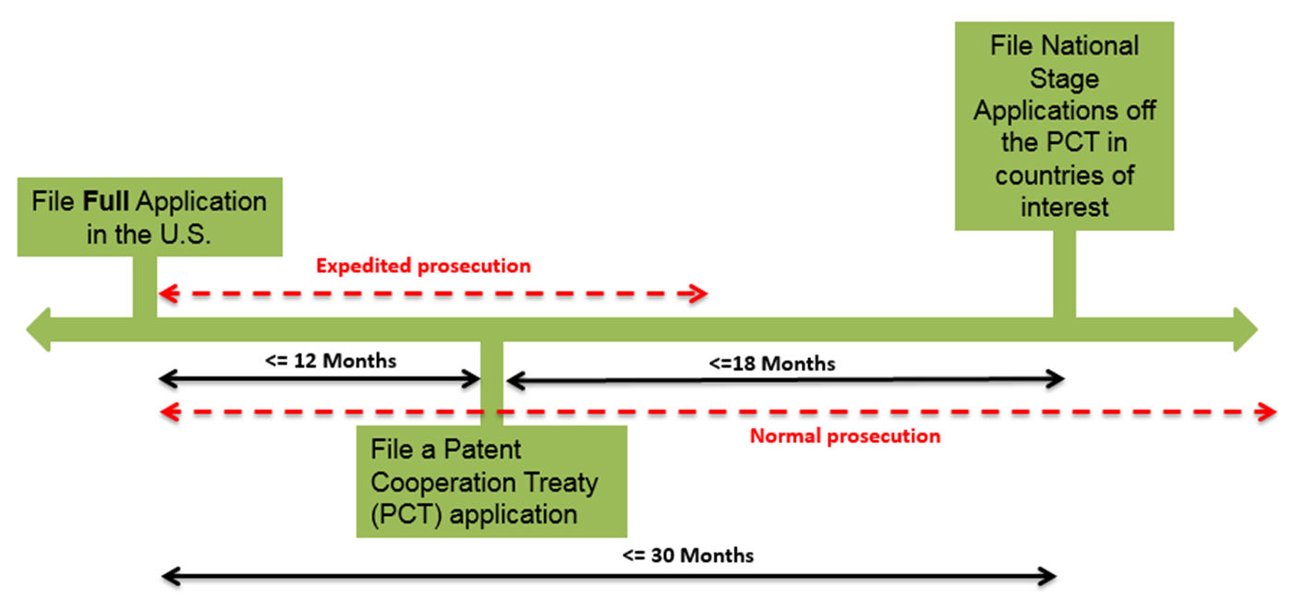
IP Fundamentals
Filing Patent Applications
Option 1/Option 3

Slide 21
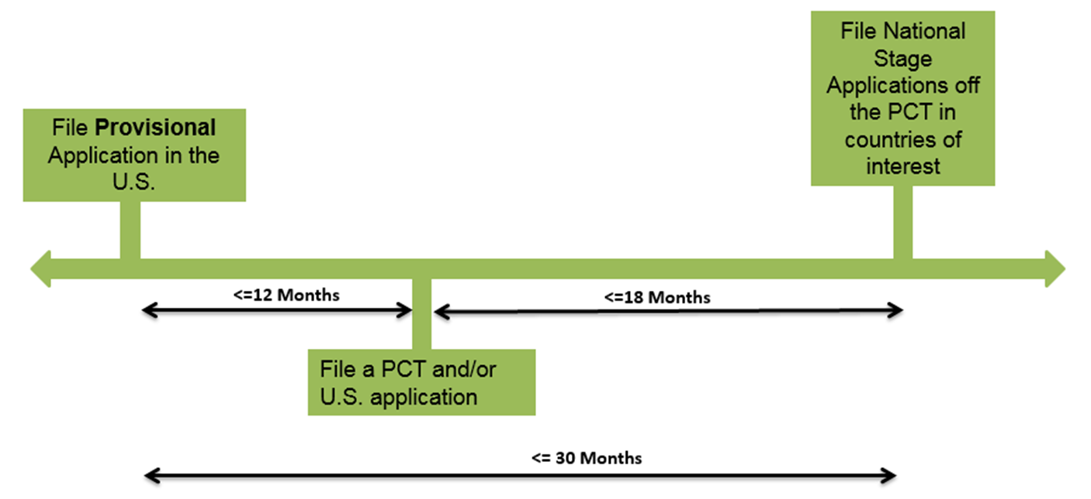
IP Fundamentals
Filing Patent Applications
Option 2

Slide 22
Importance of a Strong IP Portfolio

Slide 23
IP Objective
Presumption: A company continues to develop cutting-edge technology that provides an important commercial advantage over its competitors
Objective: Ensure the company that has a sufficiently strong, broad and deep IP portfolio to preserve that advantage
Why?
In the emergence of each technology sector, technology initially dominates the business success formula
At some point however in each technology sector, IP becomes critical to maintain competitiveness and market share
The early and/or prolific IP property holders gain great leverage
Once the IP enforcement game begins being played in a sector it is insufficient to only have good technology
If you don’t have good IP, you will be severely disadvantaged and it may not matter how good your technology is

Slide 24
Why Should a Company Have a Strong Portfolio
Because a strong IP portfolio…
Provides defensive ammunition / litigation counterclaim fodder
Can act as a deterrent to being sued (mutually assured destruction)
Preserves market position established by technology leadership
Prevents theft of ideas
Allows patentee to control usage / evolution of patented technology through strategic licensing arrangements
Injects entrepreneurial culture into R&D function
Captures R&D spending to create tangible asset that can be sold or licensed to generate independent revenue stream

Slide 25
Frequently Asked Question
“I own a patent. Can I practice the invention that is claimed in the patent?”
Not necessarily
A patent grants the patent owner the right to prevent others from making, using, and selling it to others.
It is a negative right; not an affirmative right to practice the invention.
If making the claimed invention infringes someone else’s patent, then the patent owner cannot make, use, or sell his own invention without the permission of the other patent’s owner.
The invention may be illegal to sell (an unapproved drug?).
Tip - conduct a Freedom to Operate (FTO) study prior to practicing any technology

Slide 26
Types of Patent Applications

Slide 27
Types of Patent Applications
Provisional
Utility (Non-provisional)
Patent Cooperation Treaty (PCT) application
Design Application – protects the ornamental features of an object; not nearly as common as utility applications.
Plant Application – protects distinct and new varieties of plants that are asexually reproduced.

Slide 28
Provisional Application
Never examined, never will issue as a patent.
Automatically expires in 12 months.
Think “place holder” for priority date.
Provides 12 months to further refine the invention (BUT added matter only gets the new date!).
Must be “re-filed” as a Utility or PCT application within 12 months of filing date to maintain priority date.
Claims of later filed Utility must be fully supported by provisional application to be entitled to filing date of the provisional application.
Tip – file comprehensive provisional application if possible.

Slide 29
Why File a Provisional Application
Provides 12 additional months to refine the invention before filing a utility application.
Allows additional improvements made within those 12 months to be rolled into a single utility application and a single PCT application.

Slide 30
Utility Application
Application that is examined by the USPTO and may ultimately be granted as a patent.
Protects the functional or structural (not ornamental) aspects of an invention.
This is the text that may ultimately be granted as a patent (after possible amendments to the claims).
After filing, no substantive changes can be made without risking a “new matter” rejection.
During pendency of a “parent” utility application, one can file “continuing applications” such as a:
Divisional - same specification as parent but different invention
Continuation - same specification and general invention as parent
Continuation-in-Part - specification has added matter

Slide 31
PCT Application
International “place holder” for filing date.
PCT must be filed within one year of priority application.
Does not issue as a patent.
Applicant must eventually proceed with actual filings in countries of interest (“national phase” filings) (153 PCT contracting states).
The granting of patents remains under the control of the national or regional patent Offices.
Convenient way to keep options open globally before deciding in which countries to pursue applications.

Slide 32
Why File a PCT Application
Advantages of the PCT route:
Defers expenses while preserving priority date for up to 30 months.
Allows time to assess marketability and patentability before making significant patent filing investments abroad.
An International Search Report and International Preliminary Report on Patentability are provided.
Disadvantages of the PCT:
Additional cost of filing the PCT application.
Delays start of prosecution, so may delay issuance of patents.

Slide 33
Anatomy of a Utility Application
Specification
Written description of the invention
How to make and use
Abstract (short summary)
Can contain figures (important for devices)
Claims
Purpose of the specification is to support the claims (e.g., teach how to make and use).

Slide 34
Anatomy of a Utility Application
Title of Invention
Cross-Reference to Related Applications
Statement Regarding Federally Sponsored Research or Development (if applicable)
Reference to Sequence Listing, a Table, or a Computer Program Listing Compact Disc Appendix (if applicable)
Background of the Invention
Brief Summary of the Invention
Brief Description of the Drawings (if any)
Detailed Description of the Invention (including Examples)
Claims
Abstract
Drawings (if any)

Slide 35
Patent Claims
Most important part of the application
The patent claims define the subject matter protected
Thus, to secure broadest rights, claims must avoid unnecessary limitations
Must define an invention that is novel and non-obvious.
Define what patentee can prevent others from making, using or selling.
Whole purpose of the application: support the claims.
Must be clear enough for skilled practitioners to determine whether a process/product would infringe.
Claim language is unusual.

Slide 36
Anatomy of a Patent Claim
Independent and dependent Claims.
Claims 1 and 2 are independent claims.
Claim 3 is a dependent claim.
A chair comprising a seating surface, four legs, and a back.
Preamble - “A chair”
Transitional Phrase - “comprising” / “consisting of”
Body - “a seating surface, four legs, and a back”
A chair consisting of a seating surface, four legs, and a back.
The chair of claim 1, wherein the back is made of wood.

Slide 37
Classes of Claims
Apparatus - Directed to what the invention is (product) not what it does
System - Directed to a combination of multiple devices
Method - Directed to a way of doing something
Composition of matter - Directed to products where the chemical nature of the substance or materials used, rather than the shape or form of a product, is the distinguishing characteristic
Product-by-process - a product, but recite the steps of the process that create the product

Slide 38
Patent Application Examination

Slide 39
General US Prosecution Outline
File Application
Possible Formality Issues – Notice to File Missing Parts and Possible Restriction Requirement
First Examiner’s Office Action
Applicant’s Reply to First Office Action
Final Examiner’s Office Action
Applicant’s Reply to Final Office Action
Conclusion of Prosecution (allowance or abandonment)

Slide 40
What are the Requirements for Patentability?
Must comply with the:
Statutory Subject Matter Requirement—35 USC § 101
Novelty Requirement—35 USC § 102
Non-Obviousness Requirement—35 USC § 103
Written Description Requirement—35 USC § 112(a)
Enablement Requirement—35 USC § 112(a)
Best Mode Requirement—35 USC § 112(a)
Definiteness Requirement—35 USC § 112(b)

Slide 41
First-to-File
The AIA’s first-to-file rules apply to patent applications having at least one claim with an effective filing date after March 15, 2013
Old Law – Novel Unless:
the invention was known or used by others in this country, or patented or described in a printed publication in this or a foreign country, before the invention thereof by the applicant for patent
New Law – Novel Unless:
“the claimed invention was patented, described in a printed publication, or in public use, on sale, or otherwise available to the public before the effective filing date of the claimed invention”

Slide 42
The Statutory Subject Matter Requirement
Requires that the invention fall into a category that Congress has designed the patent laws to protect.
US law specifies four categories of patent-eligible subject matter:
process (or method) - including machine learning algorithms, bioinformatics methodologies, etc.
machine - machine learning systems, computational devices, digital circuitry, embedded systems, user interfaces, computer software embodied in a physical medium, etc.
manufacture
composition of matter

Slide 43
The Statutory Subject Matter Requirement
Court interpretations of the statute have defined the limits of patentable subject matter and there have been major changes/tightening over the few years.
Judicially created exceptions to those four categories:
Product of Nature
Laws of Nature
Natural Phenomena
Abstract Ideas
A claim that falls within one these exceptions is not valid.

Slide 44
The Novelty Requirement
Requires that the invention not be in the public domain prior to the filing of the patent application:
Patenting of the invention
Publication of the invention
Public use of the invention
Sale or offer for sale of the invention
File priority application before any public disclosure, or use, or sale, or offer for sale (“bar dates”).

Slide 45
The Novelty Requirement
Public Disclosure and Grace Period
An inventor’s public disclosures will not preclude a patent in the US, if the patent application is filed within one year of the disclosure.
AKA the “grace period”
An inventor’s public article and speeches are not prior art if made within one year of patent application.
But rights may be lost abroad!
Best practice is to file a patent application before any public disclosure occurs!!!

Slide 46
The Novelty Requirement
Typical bar date triggers:
Journal articles
Product release brochures
Conference presentations, abstracts
Disclosures not protected by non-disclosure agreement (NDA)
Website postings
Selling/Offering for sale (even under a secrecy agreement)

Slide 47
The Non-Obviousness Requirement
Even if novel, invention is not patentable if it differs from the prior art only by way of an “obvious” modification.
“Obvious” means obvious to a person of ordinary skill in the art at the time the invention was made.
Keeps inventor from claiming something that is not inventive over something belonging to the public or someone else.
Highly subjective.

Slide 48
The Enablement Requirement
Requires the specification to teach one of skill in the art how to make and use the invention without undue experimentation.
Inventor should describe how to practice the invention – no “hiding the ball.”
Frequently an issue for the “unpredictable arts” (biology and chemistry), especially for unproven methods of treatment.

Slide 49
IP Do’s and Don’ts for Startups

Slide 50
IP Do’s and Don’ts Roadmap
Don’t Start Before You’re Ready
Don’t Assume Your Technology Will Determine Your Best Business Model
Do Involve IP Counsel Early
Do Develop an IP Strategy
Don’t Skimp on Your IP Budget
Do Get Help to Manage Your IP
Don’t Ignore Competitors’ Patents
Do Think About Collaborations
Don’t Overlook the IP Details
Don’t Forget IP as Part of your Exit Strategy

Slide 51
Don’t Start Before You’re Ready
When should a company/start-up spin out of a university?
What is the role of the university (it varies)
Define the investment (market) opportunity
Scientist founder vs. experienced executive
Bridge notes + grants vs. seed round
Stake out the IP!
Recruit the very best → People make you successful

Slide 52
Don’t Assume Your Technology Will Determine Your Best Business Model
You have your technology – now what to do with it?
Owning a technology, e.g., a device or drug candidate, does not immediately imply what the correct business model should be
Building a business model around your assets that maximizes ROI is a key decision and laden with assumptions, some of which may be testable given resources (i.e., real market research)

Slide 53
Do Involve IP Counsel Early
Hire an IP attorney prior to launching your product and prior to any public disclosure of your technology
If you wait until after disclosures have occurred and/or barring deadlines have passed you may have irreparably lost valuable IP rights
U.S. law provides a one-year “grace” period to file your application after your first sale or a public disclosure
Some foreign countries have NO grace period
The bottom line - protect your IP rights early

Slide 54
Do Develop an IP Strategy
Work with your counsel to develop an overall IP strategy
Identify the goals of your IP portfolio and develop a global strategy
Develop a budget and filing schedule and identify the technologies to be protected
The IP strategy should identify the types of IP (e.g., patents, trademarks, copyrights, or trade secrets) that will best protect your products
A company can waste time and money by randomly trying to protect IP that does not conform to a clear strategy

Slide 55
Don’t Skimp on Your IP Budget
Intellectual Property – clearly required from a VC perspective
How much money should you spend on IP acquisition, analysis (e.g., freedom-to-operate opinion), and enforcement?
A detailed FTO analysis can cost many tens of thousands of dollars, a litigation can cost millions
Protecting IP can be expensive, but it is critical to develop a realistic budget for your global IP strategy
When you do this analysis is an important decision and ‘first’ is not necessarily the correct answer

Slide 56
Do Get Help to Manage Your IP
When should a start-up consider getting in-house IP management?
Friends / associates vs. the very best
Hire for the intermediate to long term
Choose in-house IP counsel based on in-house experience and/or law firm experience

Slide 57
Don’t Ignore Competitors’ Patents
Don’t assume that you can market and sell your product just because you own a patent or maintain a trade secret
Patents provide the right to exclude, NOT to practice the invention
Consider your freedom to operate (FTO) before you design your commercial products
Budget both time and money to identify competitor patents that may prevent you from making or selling your product

Slide 58
Do Think About Collaborations
When should a start-up get a collaboration partner?
Development costs
What type of partner - big pharma vs. biotech?
The economics
Partnership options
Co-marketing rights
Indications / markets
Geographic
Collaboration vs. trade sale
But, always consider the IP aspects of such collaborations, and keep close track of who invented what aspects of the collaboration

Slide 59
Don’t Overlook the IP Details
Make sure that the company, not the employees or principals, own the IP
All patent applications should be explicitly assigned to the company as early as possible
Failing to secure and maintain IP rights (e.g., by the proper use of assignments, nondisclosure agreements, employment agreements, and vendor agreements) can cost your company valuable IP rights

Slide 60
Don’t Forget IP as Part of your Exit Strategy
Your IP portfolio can be very important depending on your exist strategy
Initially, patents and patent applications can be a form of advertising to potential investors
Angel Investors tend to be interested in the technology covered by your patents
VCs tend to be interested in the size of your patent portfolio and potential to keep competitors out of your space
If you intend to grow your company as your exit strategy, your IP portfolio should be focused on keeping competitors out of your space
The validity and breadth of scope of your patents is tantamount
The number of patents may be less relevant in this scenario
Patents and patent applications can be a form of advertising to potential buyers of your company
Companies interested in acquiring your company will typically do a complete due diligence review of your entire IP portfolio
Some companies are interested in the total number of patents and applications in your portfolio

Slide 61
Memorialize Work

Slide 62

Lab Notebooks are Still Important!
Still need to get inventorship right to get all assignments perfected
Preserve the story of the invention for litigation purposes
Prove that you did not derive from another

Slide 63
Do’s and Don’ts for Lab Notebooks
Do use bound books
Inventors should use permanently bound notebooks, e.g., notebooks with spiral or glue bindings. If loose-leaf sheets are used, they should be consecutively numbered and each page should be dated, signed, and witnessed.
Do sign and date
Each notebook should be signed and dated on the inside front cover to indicate the first day the recipient started using the notebook. Each entry should be dated and signed or initialed. An independent witness, i.e., someone who understands the technology, but will not be named as a co-inventor of the invention, should sign and date each entry after the statement: “Read and understood by .” (The witness should preferably sign the entries on a contemporaneous or fairly contemporaneous basis, but entries can also be reviewed, signed, and dated on a periodic, e.g., weekly or monthly, basis.)
Do use ink
Notebook entries should be made in ink and in chronological order. Entries should not be erased or “whited out.” If an entry contains an error, a line should be drawn through the error and new text should continue in the next available space.

Slide 64
Do’s and Don’ts for Lab Notebooks
Don’t leave blank spaces
Blank gaps between entries should be avoided. If a blank space is left on a page, a line or cross should be drawn through the blank space, and the page dated to prevent subsequent entries.
Don’t modify
Prior entries should not be modified at a later date. If data were omitted, the new data can be entered under a new date and cross-referenced to the previous entry. Record experiments when they are performed.
Do use past tense
Use the past tense (e.g., “was heated”) to describe experiments that were actually performed.
Do explain abbreviations and special terms
Explain all abbreviations and terms that are nonstandard. Explain in context, in a table of abbreviations, or in a glossary.

Slide 65
Do’s and Don’ts for Lab Notebooks
Do staple attachments
Attachments such as graphs or computer printouts should be permanently attached to pages in the notebook (e.g., by stapling), and both the attachment and the notebook page signed and dated. If the attachment cannot be stapled, it should be placed in an envelope and the envelope stapled to the notebook page. The envelope and page should then be signed and witnessed making reference to the attachment being placed in the envelope.
Don’t remove originals
No original pages should be removed from the notebook.
Do outline new experiments
When a new project or experiment is started, the objective and rationale should be briefly outlined (e.g., in a short paragraph or by providing a flowchart).
Do record lab meeting discussions
Relevant discussions from lab meetings should be recorded and dated as should ideas or suggestions made by others. The names of the people making the ideas and suggestions should be carefully documented. This information may be important in establishing inventorship.

Slide 66
Do’s and Don’ts for Lab Notebooks
Do provide detail
Record test descriptions, including preferred operating conditions, control conditions, operable and preferred ranges of conditions, and alternate specific materials. Also record test results and an explanation of the results, as well as photos or sketches of the results and/or the test device. Any conclusions should be short and supported by the factual data. Avoid opinions or speculation about the invention.
Do track notebooks
Ideally, each lab should maintain a catalog of notebooks in which each notebook is assigned a number, and the name of the author of each notebook is recorded. In addition, the date the author received the notebook as well as the date the notebook was completed and returned should be recorded. Upon leaving the lab, the author should return all notebooks checked out by or to him.
Do save completed notebooks
All completed notebooks should be indexed (e.g., by number, by author, and/or by subject area) and kept safely in a central repository, together with or at least referencing corresponding patent applications or patents. Lab notebooks that relate to inventions on which patents have been granted should be kept for the life of the patent plus six years.

Slide 67
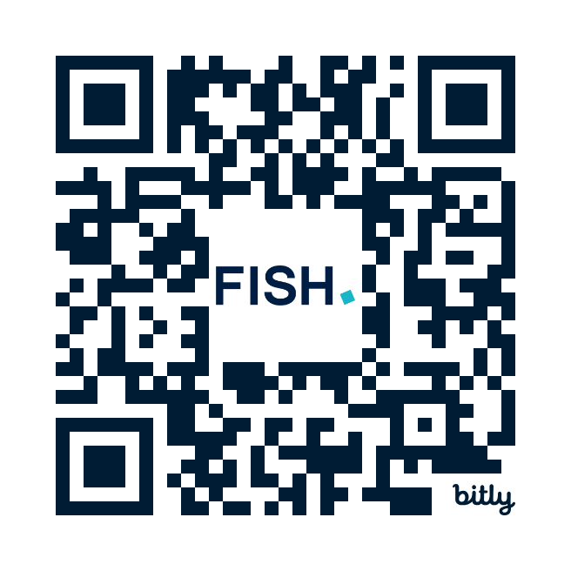


Slide 68


Thank You!
Jeff Barclay
Peter J. Fasse
Principal
Barclay@fr.com
Principal
peter.fasse@fr.com

Slide 69

Jeffrey Barclay
Principal | Boston, MA
617-368-2191 | barclay@fr.com
J.D. Franklin Pierce Law Center
M.S. Northeastern University; Electrical Engineering
B.S. Northeastern University; Electrical Engineering
Provides strategic counseling and helps companies build and monetize their intellectual property portfolios.
Prosecution experience includes preparation and prosecution of patent applications, due diligence investigations, patentability and freedom to operate opinions, and inter partes and ex parte reexamination proceedings.
Has extensive experience building global patent portfolios, licensing technologies, and assisting with litigation matters.
Works with companies across a broad range of technologies, including signal processing, software and computer engineering, imaging devices, wireless devices and other electromagnetic based systems, consumer products, robotics, artificial intelligence, telecommunication, and analog and digital circuitry.
Started his career as an electrical engineer for over ten years with the Naval Undersea Warfare Center in Newport, Rhode Island. Along with serving as an electrical engineer in the submarine electromagnetic systems department, he also served as an electrical engineer in the submarine sonar department.

Slide 70

Peter Fasse
Principal | Boston, MA
617-521-7802 | fasse@fr.com
J.D. George Washington University Law School
B.S. Massachusetts Institute of Technology; Bioelectrical Engineering and Life Sciences
Practice focuses on prosecuting patents and counseling clients regarding wide-ranging technologies, with an emphasis on biotechnology, healthcare, medical devices, and other biological and medical fields, as well as various green technologies.
Helps clients from startups to multinationals develop competitive worldwide patent strategies and establish solid and defensible patent portfolios. He performs competitive patent analyses, identifies third-party patent risks, and provides patentability and freedom to operate opinions.
Has experience in opposing and defending patents before the EPO and in U.S. litigation and post-grant proceedings in patent infringement suits and trade secret misappropriation cases.
A go-to lawyer for medical therapeutics and diagnostics devices, and imaging, microfluidic systems, liquid biopsy, cell culturing and bioprocessing, molecular biology, complex biomedical systems, optics, machine tools, lasers, and all types of green technologies.
Named one of “The World’s Leading Patent Practitioners” by IAM (2018-2022).
Conducted a massive FTO for Constitution Medical, which was then bought by Roche for $250 million up front, with $250 million more in milestones.

